Slide 1
Finding The Hotspot For Mobile Phone Expo - 2020 Iyyanar M Jan 02, 2020 Advanced Data Science Capstone -Coursera

Slide 2
Project analysis slide 2
CONTENTS
INTRODUCTION
CLUSTER ANALYSIS
PROJECT
DATA ACQUISITION
& cLEANING
RESULT
EXPLORATORY
DATA ANALYSIS
CONCLUSION

Slide 3
Project analysis slide 3
Introduction
A Mobile Phone Expo in India for the year 2020 has been planned and the location for the expo is still undecided.
This Expo will act as a marketing campaign for major mobile phone manufacturers and local mobile stores around the location.
Customers can purchase a new mobile phone and also they can get to know the local stores, service points nearby from the expo.
The problem is to find the central hub-point, which should be located in middle of many mobile shops in a lesser distance. So, that expected amount of sponsors and customers around that area will be guaranteed to participate in the expo. Therefore, the cost of installing the expo can be reduced by more number of sponsors and profit of the expo will be increased.

Slide 4
Project analysis slide 3
Data Acquisition
& Cleaning
I have used the Foursquare API for collecting the mobile shop location data's which includes latitude and longitude values for 5 major cities in India.
The Cities are :
Bangalore,
Chennai,
Delhi,
Hyderabad and
Mumbai.
The reason behind these 5 Cities are that these cities are well known for their daily market trade and populations.

Slide 5
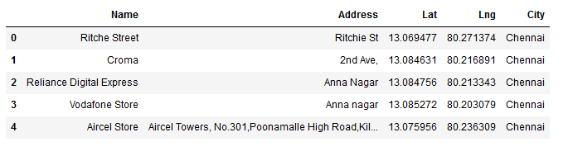
Project analysis slide 3
Data Acquisition
& Cleaning
The Data retrieved from the FourSquare API is in JSON format containing many information, which are not needed.
The information only needed for this project are shop name, latitude, longitude and city name. By using python script, only the needed data columns are selected from the JSON results.
Fig. 1 – Screenshot of the Dataset.

Slide 6
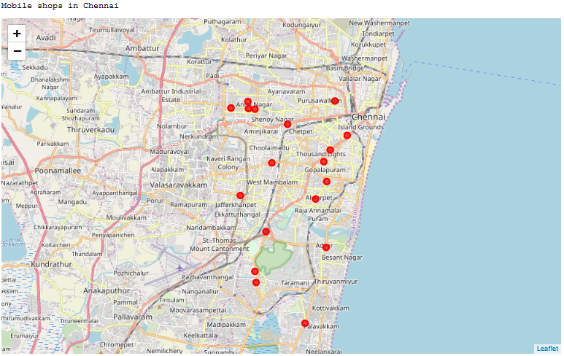
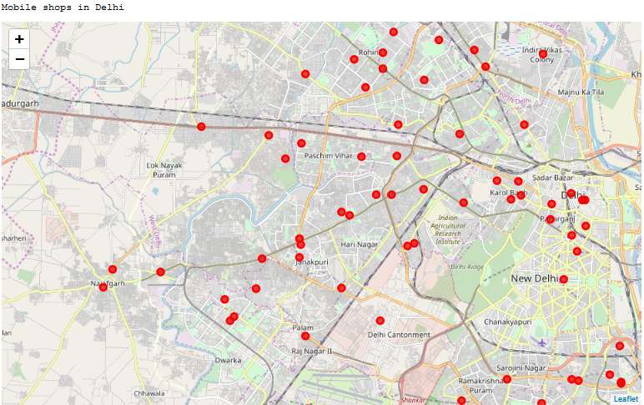
Project analysis slide 3
Exploratory
Data Analysis
DATA VISUALIZATION :
The Dataset which we collected needs to be analyzed. Since, it consists of latitude and longitude values. We can plot it in a graph for analysis.
Data visualization is done using folium libraries.
Fig. 2 – Screenshot of the Chennai and Delhi Dataset.

Slide 7
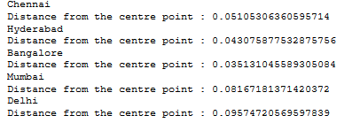
Project analysis slide 3
Exploratory
Data Analysis
DISTANCE FRO MEAN POINTS IN EACH CITY :
The calculation of the distance from a central point of those mobile shops in each city would be helpful in identifying the best city with higher number of mobile shops and also helps to find the average distance to be travelled for the Expo-2020.
These centre points are calculate by the mean average of the latitude and longitude values of each cities.
Fig. 3 – Distance from Center point in each Cities.

Slide 8
Project analysis slide 3
Cluster Analysis
K- Means Clustering Algorithm :
K-Means algorithm is an unsupervised learning algorithm.
It clusters, partitions or segments the available data points by means of similar characteristics based on labels.
The available data points are divided into non-overlapping subsets called clusters without any internal cluster structure.
Algorithm :
Randomly placing k Centroids, one for each cluster
Calculate the distance of each point from each centroid
Assign each data point to its closest centroid, creating a cluster
Re-calculate the position of the k centroids
Repeat the steps 2-4, until the centroids no longer move.

Slide 9
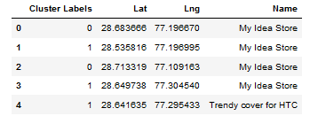
Project analysis slide 3
Cluster Analysis
After applying the k-means algorithm to the data points for delhi city with a k cluster value. We got the cluster labels for each row in the delhi dataset.
By using this cluster label, we can find the center point for each cluster to start expo in that place.
Fig. 4 – Delhi data with their Cluster labels after applying K-means algorithm

Slide 10
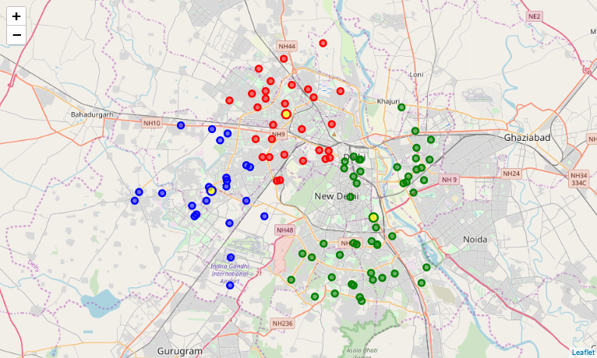
Project analysis slide 5
Result
The Result is the center hub point for each segmented cluster in Delhi.
There are 3 clusters of mobile shops located in this city and the center mid-point for each cluster can be used for starting the Expo-2020.
Fig. 5 – Cluster of Mobile Shops in Delhi with Central Hub point ( Hotspot )
The three clusters are plotted in the graph having a differentiation of markings in colors as red, green, and blue.
. Each cluster has its own center points highlighted with yellow color.

Slide 11
Project analysis slide 3
Conclusion
The project work for finding the hotspot location to start a Mobile Expo-2020 in India has been found as Delhi. Therefore, the distance from the mobile shops to the expo will be lesser and will result in participation of higher number of mobile stores, sponsors, and customers. Which will increase the popularity and sales profit of all the mobile stores around Delhi.

Slide 12
Thank You

